Slide 1
A Brief History of LGBTQIA+
Rory McLaughlin

Slide 2
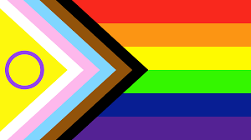
The (Gay) Agenda
What is LGBTQIA+?
Stonewall
What do all the letters mean?
Statistics on Violence, Abuse and Discrimination against LGBTQIA+ people
Criminalisation/Decriminalisation of LGBTQIA+
Iconic People of Pride
‘Genderbread Person’
Pride Flags
Movies/TV Shows/Books based around people of pride
Pride is a Protest
How to be an Ally - Machaela Cavanaugh
Local LGBTQIA+ Charities

Slide 3
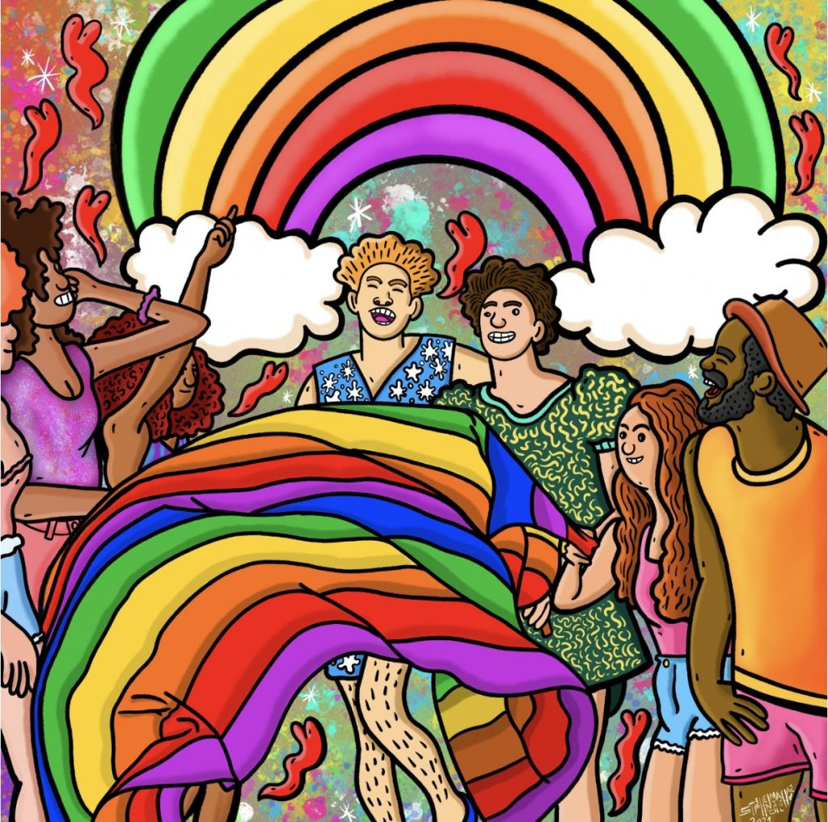
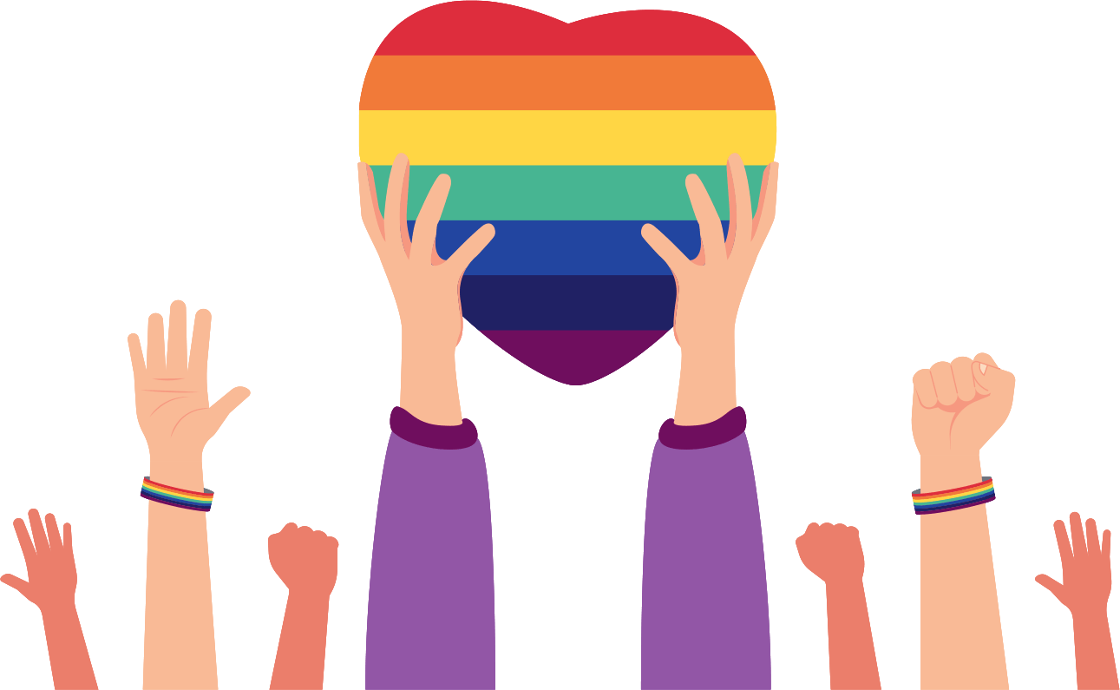
What is LGBTQIA+?
A brief history of lesbian, gay, bisexual, and transgender social movements
Bonnie J. Morris, PhD
Notes:
The terms we use today to describe a range of sexualities and gender identities – lesbian, gay, bisexual, transgender and queer – are mostly quite recent inventions. For the most part, we simply don’t know how people in the past would have described their sexuality or gender. We use the acronym LGBTQ+ because we believe it comes closest to capturing the breadth of experiences and identities for those whose sexualities didn’t fit within societal norms.
The non-specific word ‘queer’ can also be useful when talking about sexuality and gender in history. We know that for some it has negative associations – historically it has been used derisively as well as for self-identification. However, the Oxford English Dictionary reports that from the late 1980s, ‘queer’ started to be reclaimed as a neutral or positive term. It is now used to capture the complexity and fluidity of sexuality and gender, with the intention of including all experiences and identities rather than defining and limiting them. It is in that spirit of inclusivity that we use the term ‘queer’.
The terms for the community of people that encompasses people who are lesbian, gay, bisexual, transgender, queer, intersex, and asexual are as broad as that community itself: As society’s understanding, recognition, and inclusion of diverse sexual identities and gender expressions has grown, so has its acronym.

Slide 4
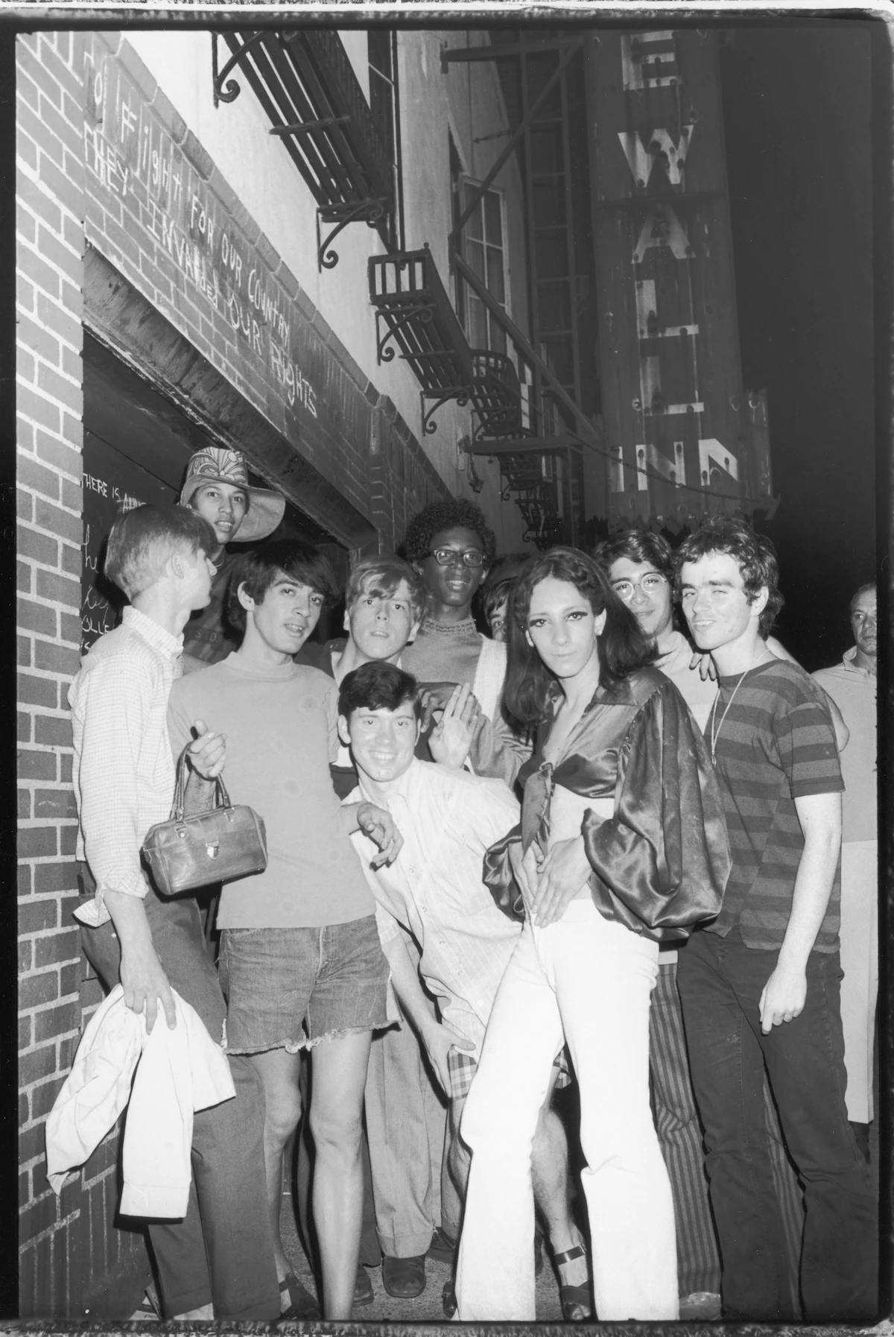
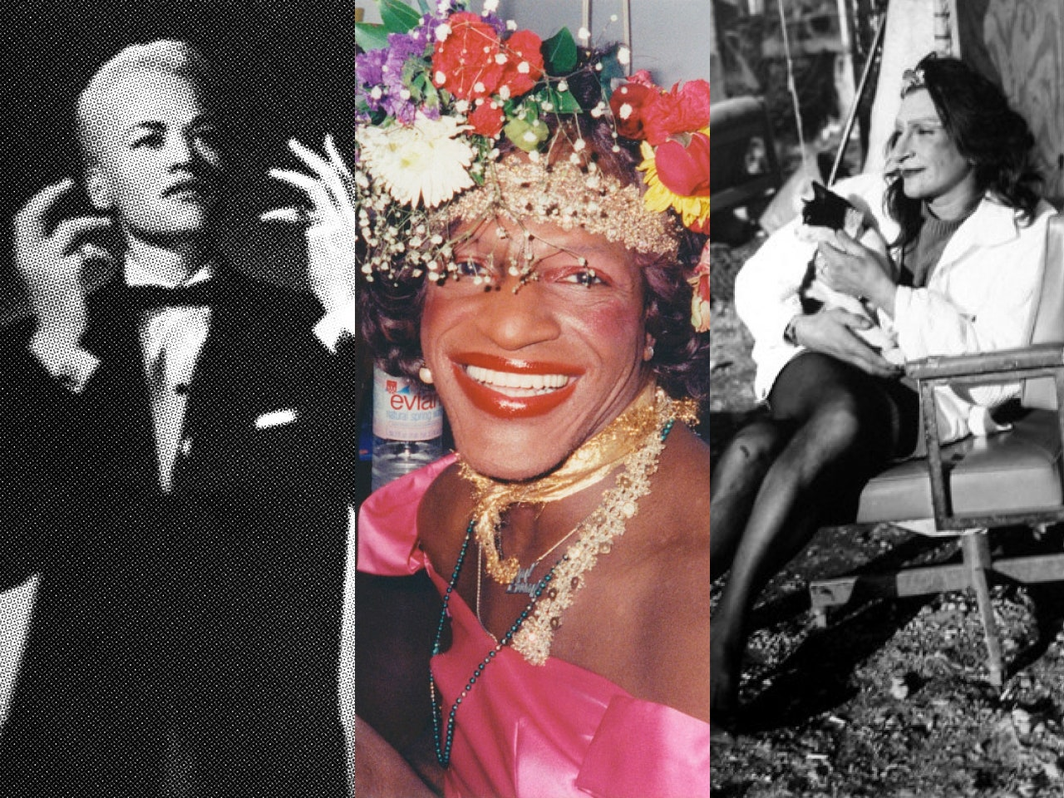
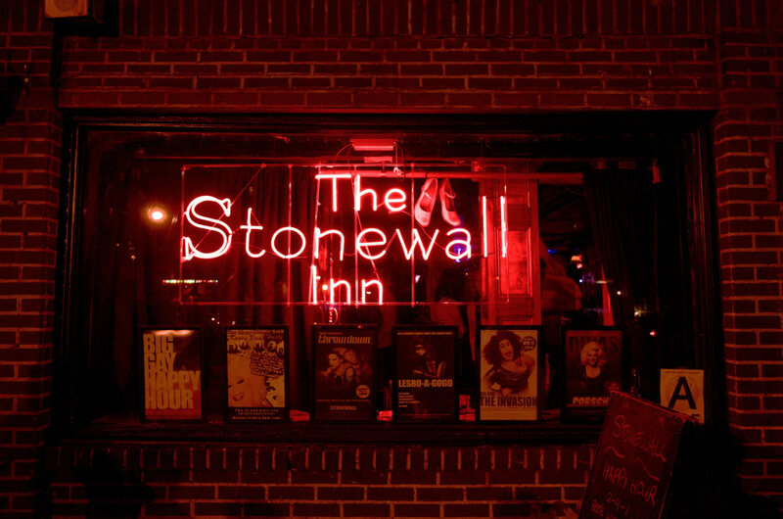
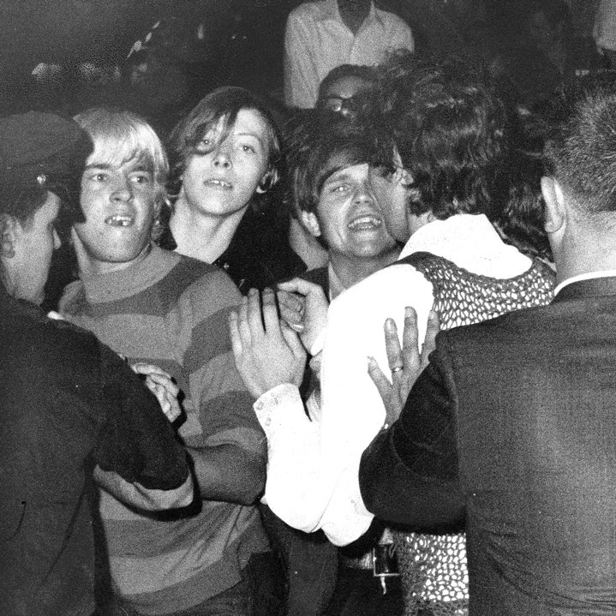
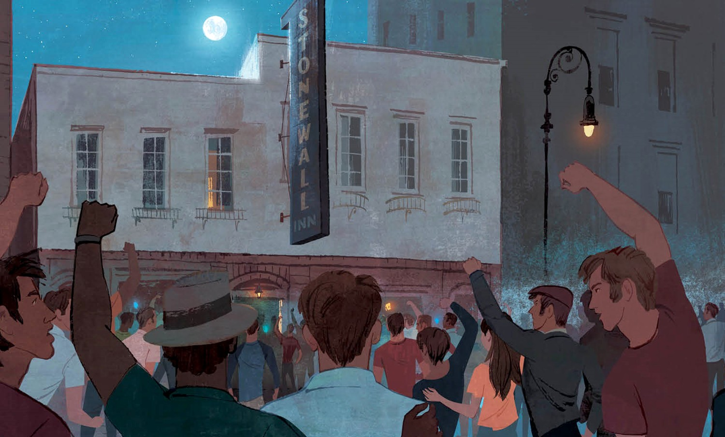
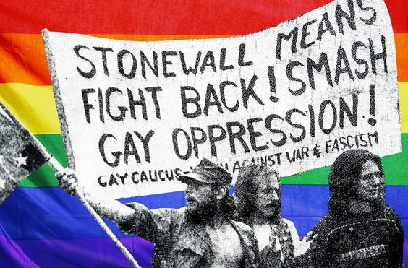
Stonewall
Pivotal moment in LGBTQIA+ history
Notes:
The Stonewall Riots, also called the Stonewall Uprising, began in the early hours of June 28, 1969 when New York City police raided the Stonewall Inn, a gay club located in Greenwich Village in New York City. The raid sparked a riot among bar patrons and neighborhood residents as police roughly hauled employees and patrons out of the bar, leading to six days of protests and violent clashes with law enforcement outside the bar on Christopher Street, in neighboring streets and in nearby Christopher Park. The Stonewall Riots served as a catalyst for the gay rights movement in the United States and around the world.
We’ll look at the context that caused this build up of tension that caused the stonewall riots
The 1960s and preceding decades were not welcoming times for lesbian, gay, bisexual and transgender (LGBT) Americans. For instance, solicitation of same-sex relations was illegal in New York City.
For such reasons, LGBT individuals flocked to gay bars and clubs, places of refuge where they could express themselves openly and socialize without worry. However, the New York State Liquor Authority penalized and shut down establishments that served alcohol to known or suspected LGBT individuals, arguing that the mere gathering of homosexuals was “disorderly.”
Thanks to activists’ efforts, these regulations were overturned in 1966, and LGBT patrons could then be served alcohol. But engaging in gay behavior in public (holding hands, kissing or dancing with someone of the same sex) was still illegal, so police harassment of gay bars continued and many bars still operated without liquor licenses—in part because they were owned by the Mafia.
When police raided Stonewall Inn on the morning of June 28, it came as a surprise—the bar wasn’t tipped off this time.
Armed with a warrant, police officers entered the club, roughed up patrons, and, finding bootlegged alcohol, arrested 13 people, including employees and people violating the state’s gender-appropriate clothing statute (female officers would take suspected cross-dressing patrons into the bathroom to check their sex).
Fed up with constant police harassment and social discrimination, angry patrons and neighborhood residents hung around outside of the bar rather than disperse, becoming increasingly agitated as the events unfolded and people were aggressively manhandled. At one point, an officer hit a lesbian over the head as he forced her into the police van— she shouted to onlookers to act, inciting the crowd to begin throw pennies, bottles, cobble stones and other objects at the police.
There are 3 people who are attributed to the revolution of Stonewall - Stormé DeLarverie, Marsha P Johnson and Sylvia Rivera. A lesbian and two transgender people. They helped take these protests to the next level and make it into a groundbreaking movement. Originally their contributions were downplayed for many years as the community did not want to associate with them but luckily times have changed and their recognition is much deserved.

Slide 5
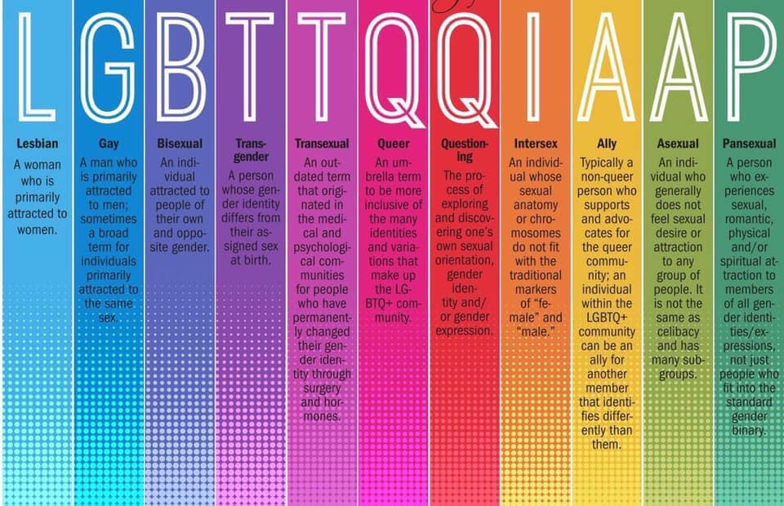
What do all the letters mean?

Slide 6
Gender-Fluid | A person who does not identify as having a single unchanging gender
Genderqueer | A person whose gender identity does not correspond to conventional binary gender distinctions
Non-Binary | A person with a gender identity that does not conform to traditional binary beliefs about gender, which indicate that all individuals are exclusively either male or female
Two Spirit/2S | male, female, and sometimes intersexed individuals who combined activities of both men and women with traits unique to their status as two-spirit people. In most tribes, they were considered neither men nor women; they occupied a distinct, alternative gender status
Cisgender | a person whose gender identity corresponds with the sex registered for them at birth i.e. not transgender.

Slide 7
Statistics on Violence, Abuse and Discrimination against LGBTQIA+
4 Times more likely
to be victims of
violent crime than
Non-LGBT people
18% have
experienced
Homelessness
at some point in
their lives
2 in 5 Trans people
have experienced a
hate crime
or incident because
of their gender
1/3 of Black, Asian
and minority ethnic
LGBT people have
experienced a
hate crime
or incident
1/2 of black, Asian
and minority ethnic LGBT people have
experienced
discrimination from others in their LGBT community
Over 1/2 of
football fans think
the
Football Association, Premier League and Football League are not doing enough to tackle
anti-gay abuse
10% of LGBT people who attended a live sporting event in the last year
experienced
discrimination
because of their sexual orientation and/or gender identity
3 in 5 fans believe
anti-gay abuse from fans dissuades gay
professional players from coming out
Stonewall Statistics
Notes:
Hate Crimes
LGBT people nearly four times more likely than non-lgbt people to be victims of violent crime
Two in five trans people (41%) have experienced a hate crime or incident because of their gender identity
One third (34%) of black, asian and minority ethnic LGBT people have experienced a hate crime or incident in the past twelve months, compared to one in five white LGBT people (20%)
Home and Communities
Almost one in five LGBT people (18 per cent) have experienced homelessness at some point in their lives.
Half of black, Asian and minority ethnic LGBT people (51 per cent) have experienced discrimination or poor treatment from others in their local LGBT community because of their ethnicity.
Sport
One in ten LGBT people (10 per cent) who attended a live sporting event in the last year experienced discrimination because of their sexual orientation and/or gender identity.
Three in five fans believe anti-gay abuse from fans dissuades gay professional players from coming out
Over half of football fans think the Football Association, the Premier League and the Football League are not doing enough to tackle anti-gay abuse

Slide 8
Criminalisation/Decriminalisation of LGBTQIA+
Sexual Offences Act 1967 for UK but only for England and Wales
Dudgeon v. United Kingdom (1981)
Other places followed after - Scotland (1981), Colombia (1981), Vanuatu (1981), Northern Ireland (1982), Micronesia (1982), Portugal (1983), New Zealand (1986), Israel (1988), and Liechtenstein (1989)
A History of LGBT Criminalisation
Notes:
Sexual Offences Act 1967
The Sexual Offences Act 1967 decriminalised private, consensual “homosexual acts” between persons aged 21 and over in England & Wales – although notably not Scotland or Northern Ireland which took until the 1980s and a decision of the European Court of Human Rights to force the UK government to reform.
The decriminalisation of same-sex sexual activity in 1967 did not bring full legal equality for LGBT people in the UK. The age of consent for same-sex sexual activity remained at 21 until 1994 when it was lowered to 18, before being equalised with heterosexual sexual activity at 16 with the introduction of the Sexual Offences (Amendment) Act 2000.
Furthermore, it remained a criminal offence for more than two men to engage in consensual sexual activity in private until the introduction of the Sexual Offences Act 2003, and new regressive laws targeting LGBT people continued to be introduced late into the twentieth century
Dudgeon v. United Kingdom
As the first successful case of its kind, the European Court of Human Rights issued its landmark judgment in Dudgeon v United Kingdom finding that Northern Ireland’s laws criminalising same-sex acts between consenting adults were a violation of the right to privacy of the European Convention on Human Rights (ECHR).
This was the first case on the issue of criminalisation to succeed under human rights law anywhere in the world and formed the basis of successful litigation in relation to the Republic of Ireland (1988) and Cyprus (1993). Male same-sex activity was decriminalised in Northern Ireland the following year.
I’m highlighting this just because it’s not that long ago that who we are and how we lived our lives was considered illegal and an offence. And if you’re thinking “1982 was 40 years ago. Ages ago!” Well the countries that didn’t criminalise or decriminalised homosexual activity before us were:

Slide 9
Didn’t Criminalise
Burkina Faso (1960)
Côte d’Ivoire (1960)
Madagascar (1960)
Central African Republic (1961)
Mali (1961)
Niger (1961)
Decriminalised
Mongolia (1961)
Czechia/Czech Republic (1962)
Slovakia (1962)
Hungary (1962)
UK – England & Wales (1967)
Bulgaria (1968)
Germany (1968-69)
Canada (1969)
Notes:
Again I’m only highlighting this to show how far we’ve come in this lovely little place we live. I’m sure these countries listed here still had violence and abuse towards LGBTQIA+ people

Slide 10
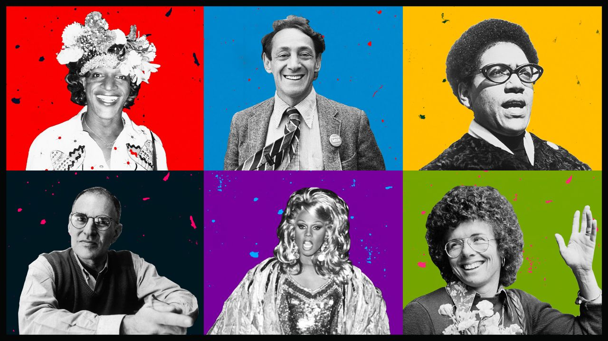
Iconic LGBTQIA+ People
Most Influential LGBTQ Activists -CNN
Notes:
Marsha P. Johnson’s name isn’t in most American history books, but it should be.
When a judge asked her about the “P” in her name, she responded that it stood for “Pay it no mind.” The judge laughed and dismissed the charges against her.
Her persistence and advocacy made her one of the most significant figures in LGBTQ and AIDS activism.
The term “transgender” wasn’t commonly used in Marsha’s lifetime, but she identified as a “transvestite,” gay and a drag queen and used she/her pronouns.
“I was no one, nobody, from Nowheresville, until I became a drag queen,” she said in a 1992 interview.
She was a sex worker and was homeless throughout parts of her life, and her activism was rooted in her experiences.
Johnson and Sylvia Rivera, a close friend of Johnson’s and a transgender rights activist, founded S.T.A.R (Street Transvestite Action Revolutionaries) to give shelter to LGBTQ homeless youth and resources.
Johnson worked as an activist participating in demonstrations and marches as part of the Gay Liberation Front, which formed in the wake of Stonewall. She was also an AIDS activist associated with the group ACT UP until her death.
Police ruled Johnson’s death in 1992 a suicide after her body was found in the Hudson river. But her friends and fellow activists believe she was killed, a theory that was the highlighted in the 2017 Netflix documentary “The Death and Life of Marsha P. Johnson.”
More than 20 years after her death, Johnson is remembered for her vibrant smile, free spirit and her contributions to the fight for LGBTQIA+ rights.
Harvey Milk was one of the first openly gay politicians elected to office in the United States, and the first openly gay official elected in California.
“We want gays to represent gays,” Milk told the San Francisco Examiner in 1977, and his position as an LGBTQ public official helped bring the community’s issues to prominence.
Milk served in the Navy for several years but resigned after being questioned over his sexual orientation.
After moving from New York to California, Milk helped start one of the first predominantly LGBTQ-owned business groups in the country, the Castro Village Association, and he was elected to San Francisco’s Board of Supervisors in 1977.
While serving as a city supervisor, he introduced legislation to protect the gay community, including a gay rights ordinance in 1978 to ban discrimination against LGBTQ in housing or employment. He and other activists also succeeded in striking down Proposition 6, which would have mandated the firing of any gay or lesbian teachers in California.
While Milk led pride marches and was widely known as a fighter for LGBTQ rights, he also fought for issues affecting the entire San Francisco population, including access for affordable housing and daycare for working mothers.
Milk was no stranger to death threats and acknowledged there was a possibility he would be assassinated. Less than a year after Milk’s inauguration as city supervisor, he and Mayor George Moscone were shot to death in the San Francisco city hall by a former fellow city supervisor over a job dispute.
When his killer was sentenced to seven years, riots broke out over what many perceived to be a lenient sentence.
In 2009, President Obama posthumously awarded Milk the Medal of Freedom to recognize his contributions as a trailblazing advocate for LGBTQ rights.
Lorde described herself as a “black lesbian feminist mother warrior poet.”
She was proud of every layer of her identity and used her own experiences to discuss the overlap between these communities.
Lorde was the daughter of immigrants, a socialist, a mother, a black woman and a lesbian. Her work addressed the different ways in which a person’s social identity, entwined with their gender, affected their lives and how others treated them.
She used her voice as a platform to fight oppression on all fronts as a civil rights activist. She founded “Sisterhood in Support of Sisters in South Africa” in the 1980s to help women of color affected by apartheid.
She wrote, “I simply do not believe that one aspect of myself can possibly profit from the oppression of any other part of my identity.”
Her writing was a revolutionary deconstruction of struggles that helped lead the Black Arts Movement. She served as New York’s poet laureate from 1991 until she passed away in 1992 from breast cancer.
Audre Lorde’s words carry on her legacy and can be seen on signs during civil rights marches around the world. Her art changed the way many see feminism and emboldened women from all backgrounds.
Larry Kramer turned his anger and grief into action.
He was one of the first to sound the alarm for the HIV/AIDS crisis in 1981 when the New York Times wrote about a rare type of “cancer” affecting gay men.
He was in the proverbial trenches fighting for LGBTQ rights and organized AIDS activists even before he was diagnosed as HIV positive.
Kramer co-founded the advocacy groups GMHC (Gay Men’s Health Crisis) and ACT UP (AIDS Coalition to Unleash Power), which coined the iconic SILENCE = DEATH logo that became a symbol for the AIDS crisis.
Kramer rose to prominence battling what he cited as negligence from the FDA and the US government. Kramer and the activists he demonstrated with were fueled by rage. They led demonstrations, blocked roads during rush hour and staged “die-ins” that grabbed media attention, eventually forcing the government to address the AIDS crisis and provide access to new treatment methods.
Kramer’s controversial calls on activists to take the AIDS crisis into their own hands helped push the FDA to eventually approve the use and distribution of experimental drugs that helped save the lives of AIDS patients. Arguably, Kramer and ACT UP are the reason countless people are alive today, because without his relentless, merciless activism, AIDS would’ve continued to take the lives of many more than it does today.
RuPaul herself! The drag godmother! Ru Paul Charles was a key figure who brought drag out of the closet and into the mainstream.
Before RuPaul, drag was viewed as an obscure subculture. The art is now appreciated by the masses as a centerpiece for entertainment.
He built a drag empire with more than 10 years of “RuPaul’s Drag Race” on VH1, including multiple spin-off shows and the launch of “DragCon” in multiple cities. But most importantly, RuPaul helped carve a place for LGBTQ culture in the mainstream.
Years of appearances in movies and TV shows, as well as a number of studio albums of his own, transformed RuPaul from a club kid to an A-list celebrity. His rise to stardom helped give drag a presence on an international scale, which later exploded into what drag culture is now.
RuPaul’s career and “Drag Race” acted as a springboard for other drag queens to make a living through performances and corporate sponsorships. His contributions to the LGBTQ community boil down to the impact he made as a pioneer in drag, and how “Drag Race” drastically changed the way millions of Americans view — and appreciate — a key facet of gay culture.
Billie Jean King has been a longtime pioneer on and off the court, using her status as a prominent athlete to champion gender equality and LGBTQ visibility.
She was the first tennis player — and woman — to be named Sports Illustrated’s Sportsperson of the Year in 1972.
After winning the US Open in 1972, she threatened to boycott the next year if men and women were not awarded the same prize money. Consequently, the tournament made the prize money the same for both sexes in 1973.
King’s career took off following the “Battle of the Sexes” in 1973, where she went head-to-head with a male tennis champion nearly twice her age, Bobby Riggs. This was watched by millions, and King said she not only wanted to win, she had to win for the sake of gender equality.
Her career took a hit in 1981 after news leaked that she was in a secret relationship with another woman while she was married to a man.
She argued with her managers and lawyers to hold a press conference so she could control the message about her sexuality.
When she publicly confirmed that she was in a lesbian relationship, she became the first out LGBTQ athlete and lost all her endorsement deals. But she likely made the road smoother for those who followed, including Martina Navratilova who lost none of her endorsement deals when she was outed just a few months later.
King was awarded the President Medal of Freedom by President Obama in 2009.

Slide 11
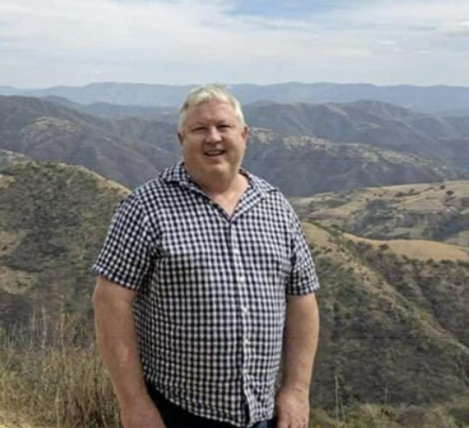
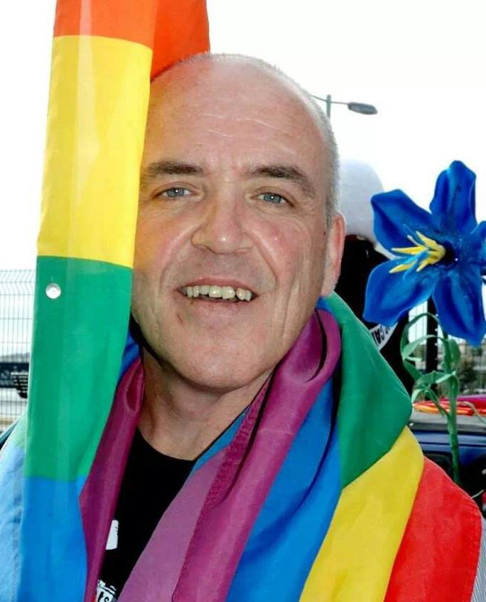
Iconic Local LGBTQIA+ People
Notes:
I put these two people in because my husband said “Why do you only have American lgbt icons?” so here’s two locals.
The one on the left is Terry Nellis. He was a gay rights campaigner from north Belfast who became a prominent activist in New York and has a street named after him over there.
Terry’s brother Brendan said “"He was part of what was known as the Lavender and Green Alliance (which celebrates Irish lesbian, gay, bisexual and transgender culture and identity) which formed in 1990”
The one on the right is Sean Morrin. He was well-known throughout the community as a member of the Rainbow Project, set up in 1994 by a group of volunteers who were concerned about the spead of HIV within the gay male population of Northern Ireland. Sean dedicated a large part of his life to campaigning for and supporting the LGBT community in Northern Ireland – he was a hero and a giant and we will miss him greatly. He was also a founding member of Foyle Pride, and a great advocate for UNISON. He also did an awful lot with the Rainbow Rehoming Centre to help rehome dogs and cats”

Slide 12
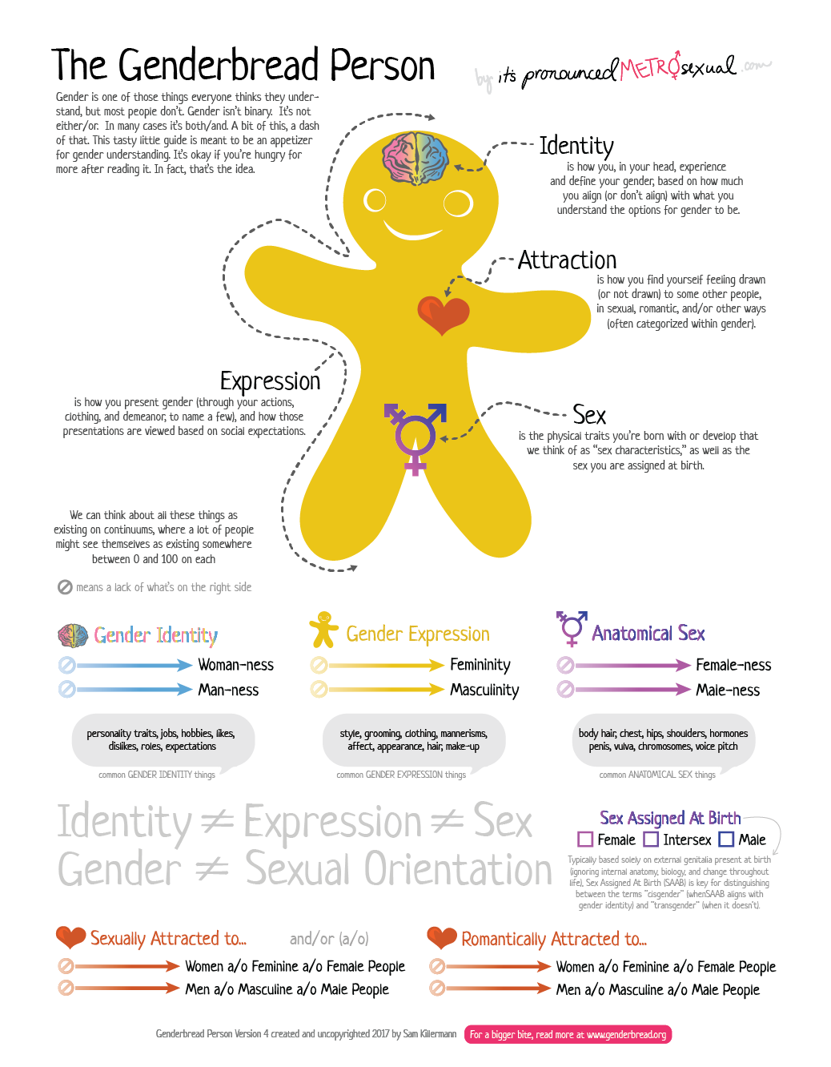
Notes:
Anatomical Sex
Sex (sometimes called biological sex, anatomical sex, or physical sex) is comprised of things like genitals, chromosomes, hormones, body hair, and more. But one thing it’s not: gender.
Gender Identity
Your psychological sense of self. Who you, in your head, know yourself to be, based on how much you align (or don’t align) with what you understand to be the options for gender.
Gender Expression
The ways you present gender, through your actions, clothing, demeanor, and more. Your outward-facing self, and how that’s interpreted by others based on gender norms.
Attraction
Like sex, attraction isn’t really a component of gender. However, we often conflate sexual orientation with gender, or categorize the attraction we experience in gendered ways.

Slide 13
Notes:
As shown here all these things are unique and do not equal each other

Slide 14
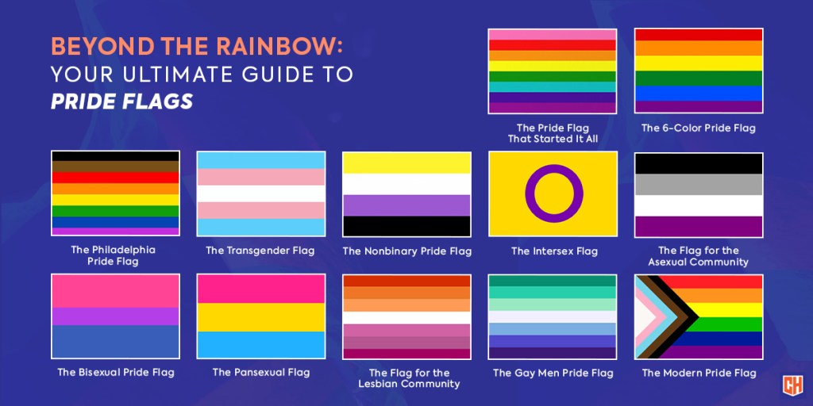
Notes:
These are some of the different version of the pride flag that have existed and branches off of the design. There are loads more but these would be the focal elements that make up the rainbow design.
The first one there was originally conceived by Gilbert Baker in 1978
The modern pride flag isn’t the most recent one

Slide 15
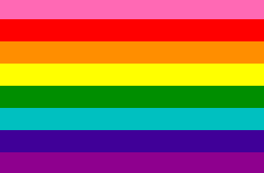
Hot Pink
Red
Orange
Yellow
Green
Turquoise
Indigo
Violet
Sex
Life
Healing
Sunlight
Nature
Magic
Serenity
Spirit
Gilbert Baker 1978 Original Pride Flag
Notes:
So this is it here. Baker assigned a specific meaning to each colour: pink for sex, red for life, orange for healing, yellow for sunlight, green for nature, turquoise for magic, indigo for serenity and violet for spirit
They removed the pink simply because the fabric wasn’t readily available and merged the turquoise and indigo into blue because of a redesign for a parade in 1979. After this, the iconic 6 colour rainbow design became the standard going forward

Slide 16
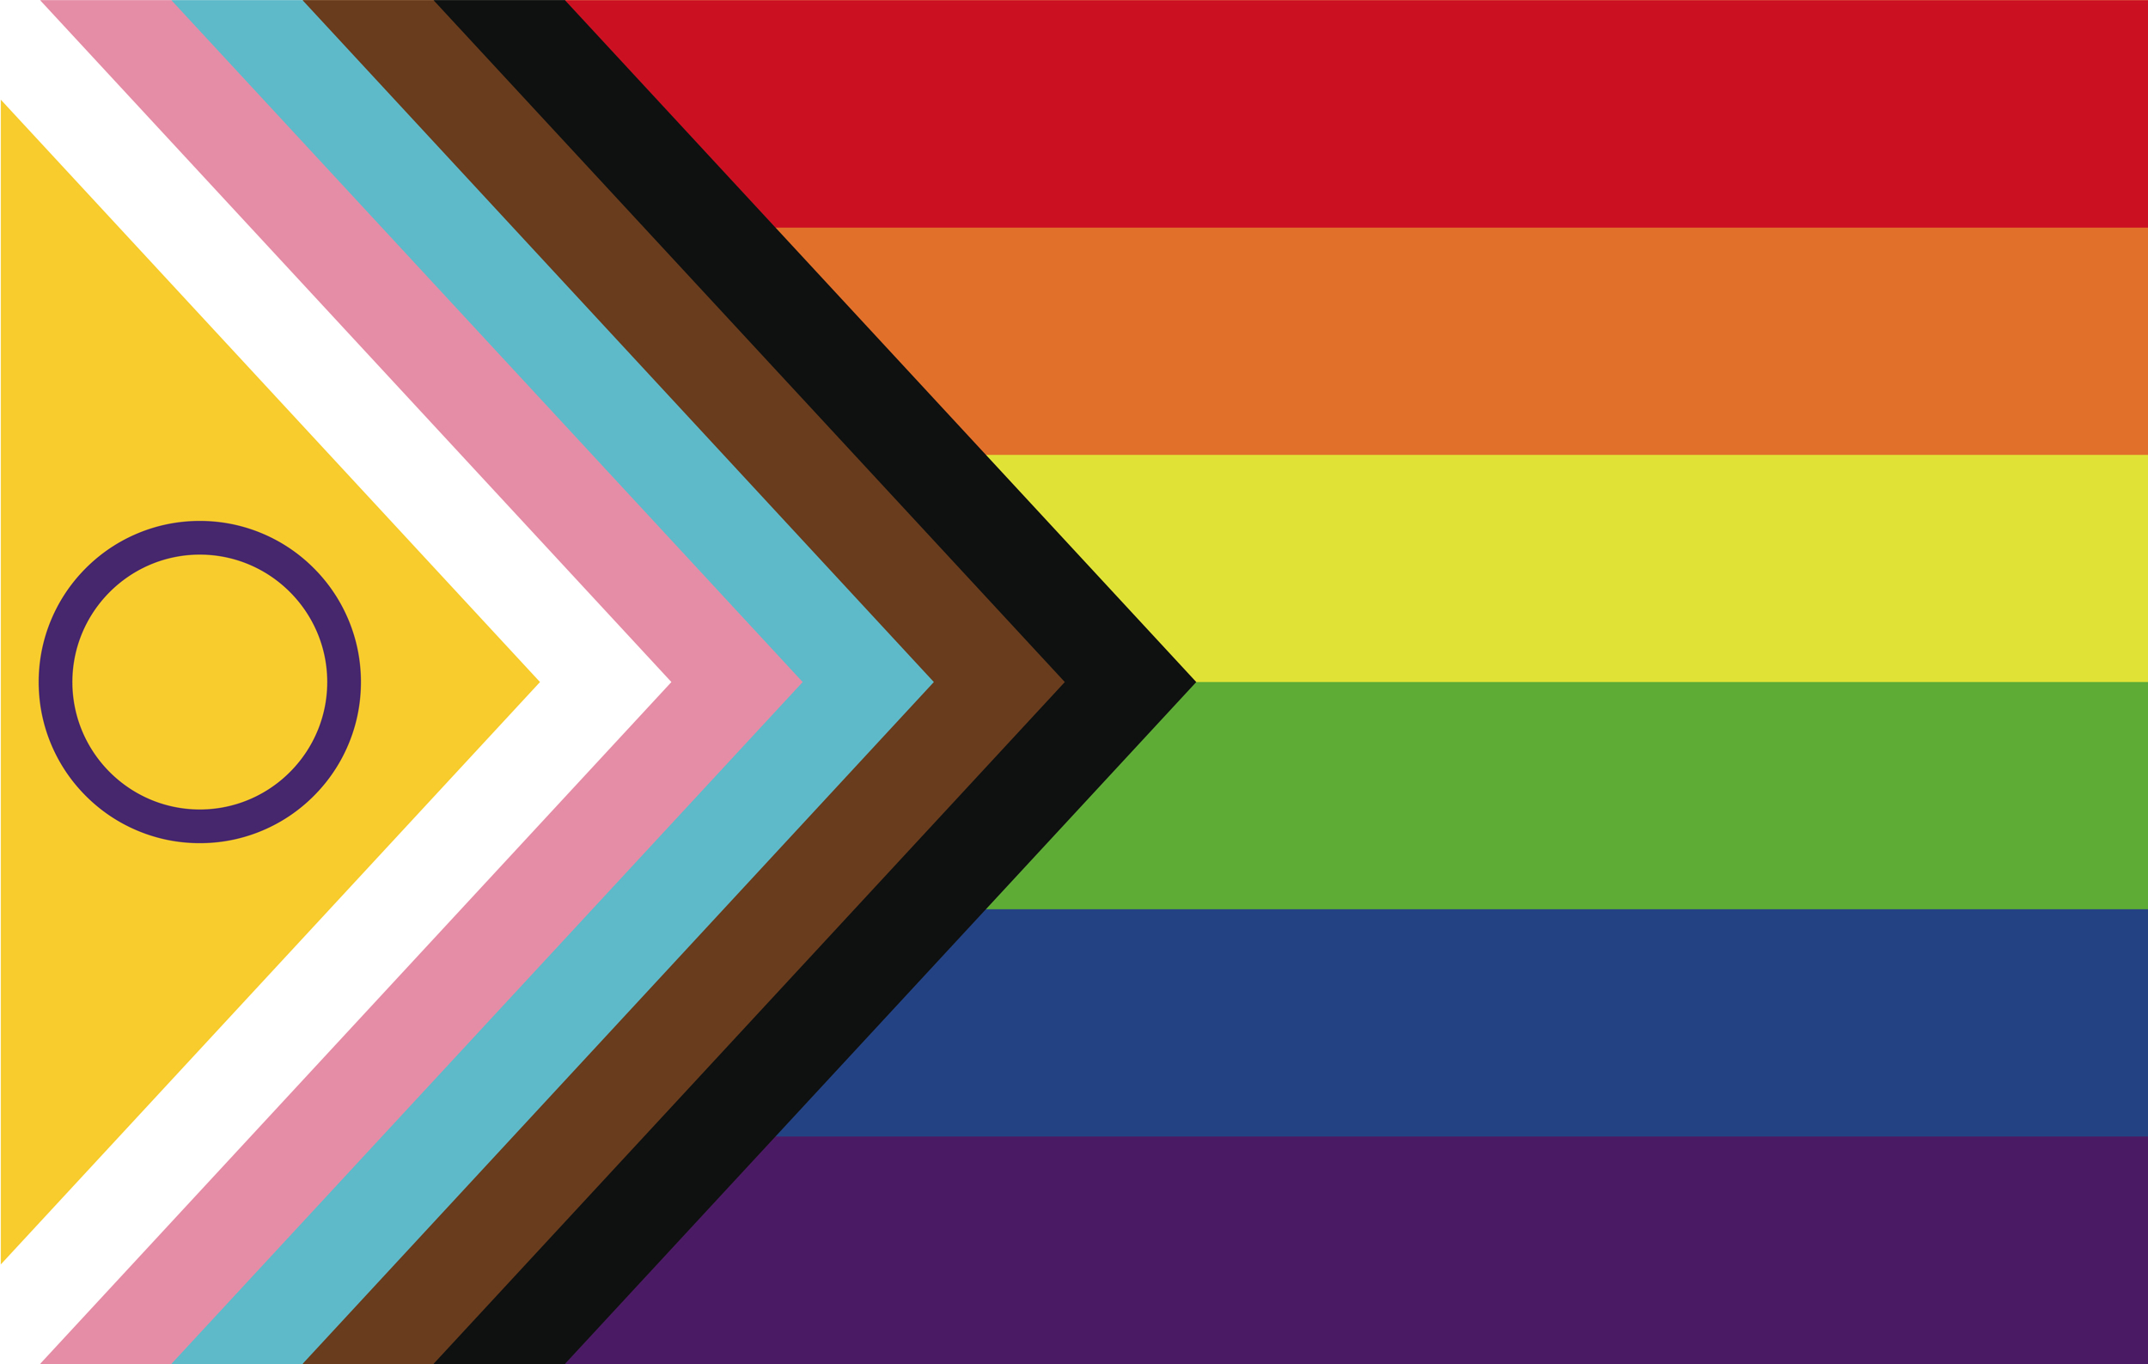
Progress Pride Flag

Slide 17

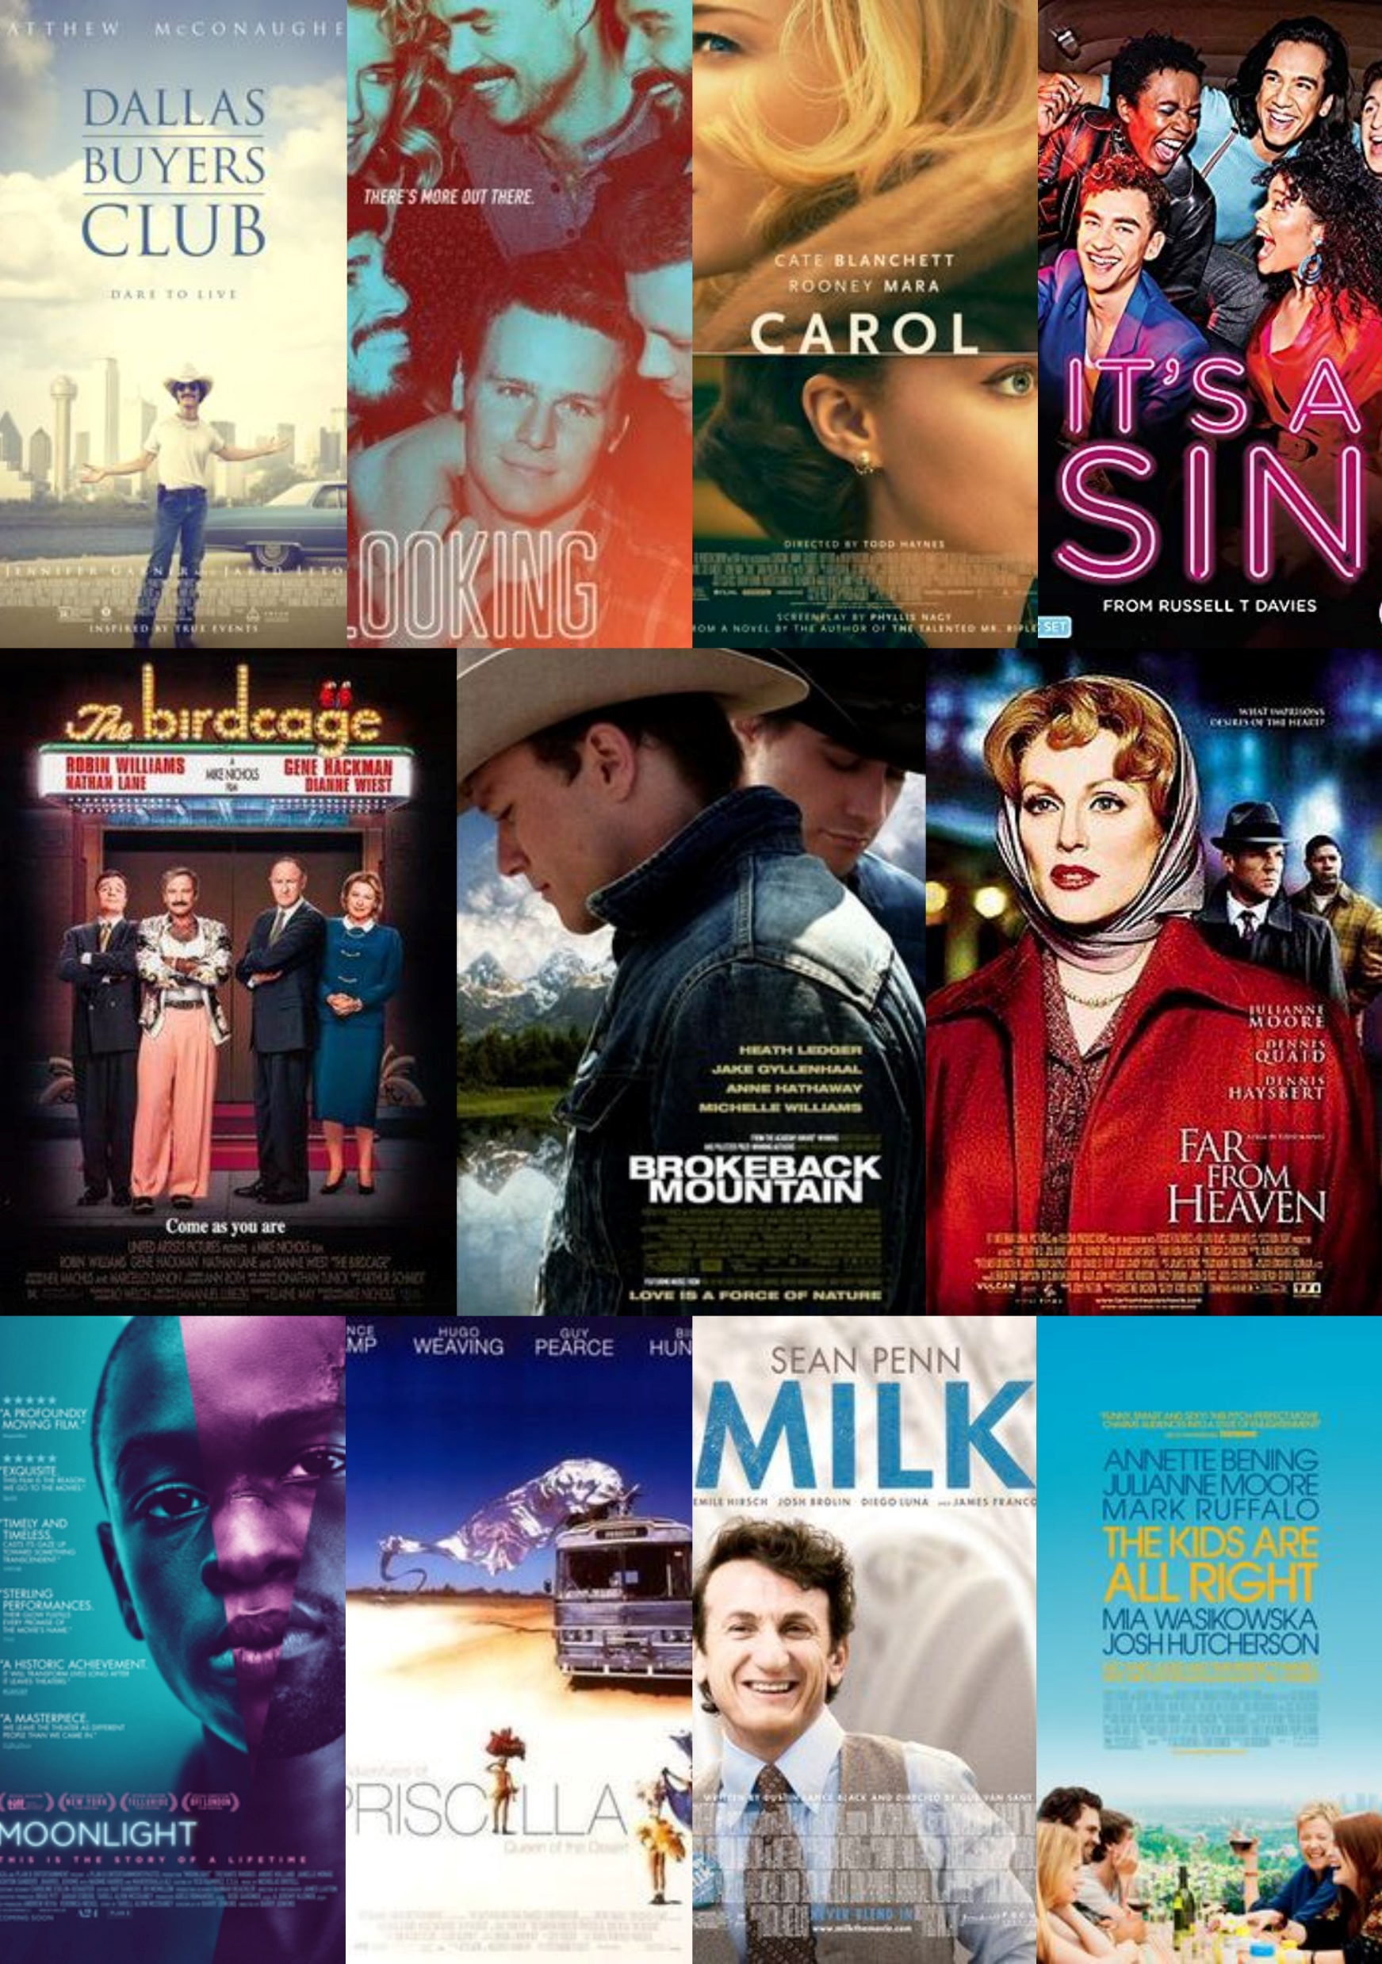
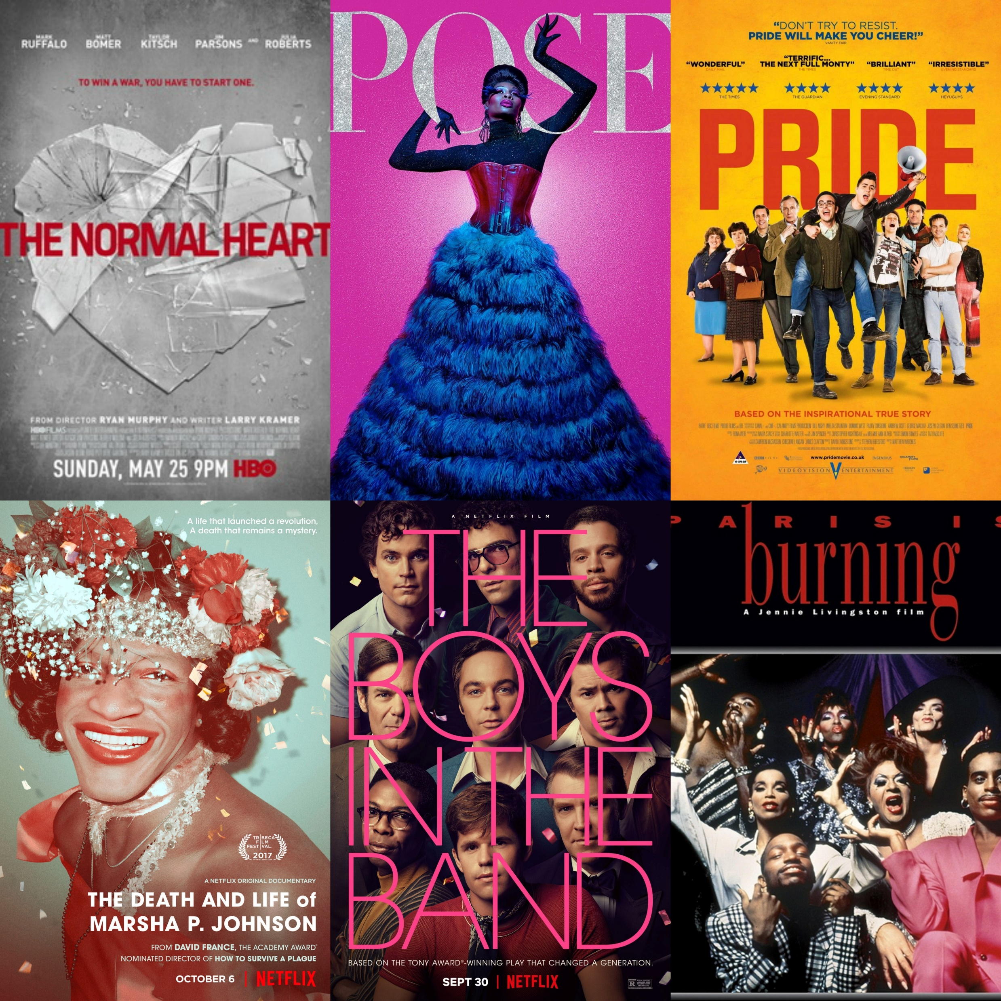
LGBTQIA+
in Film and TV

Slide 18
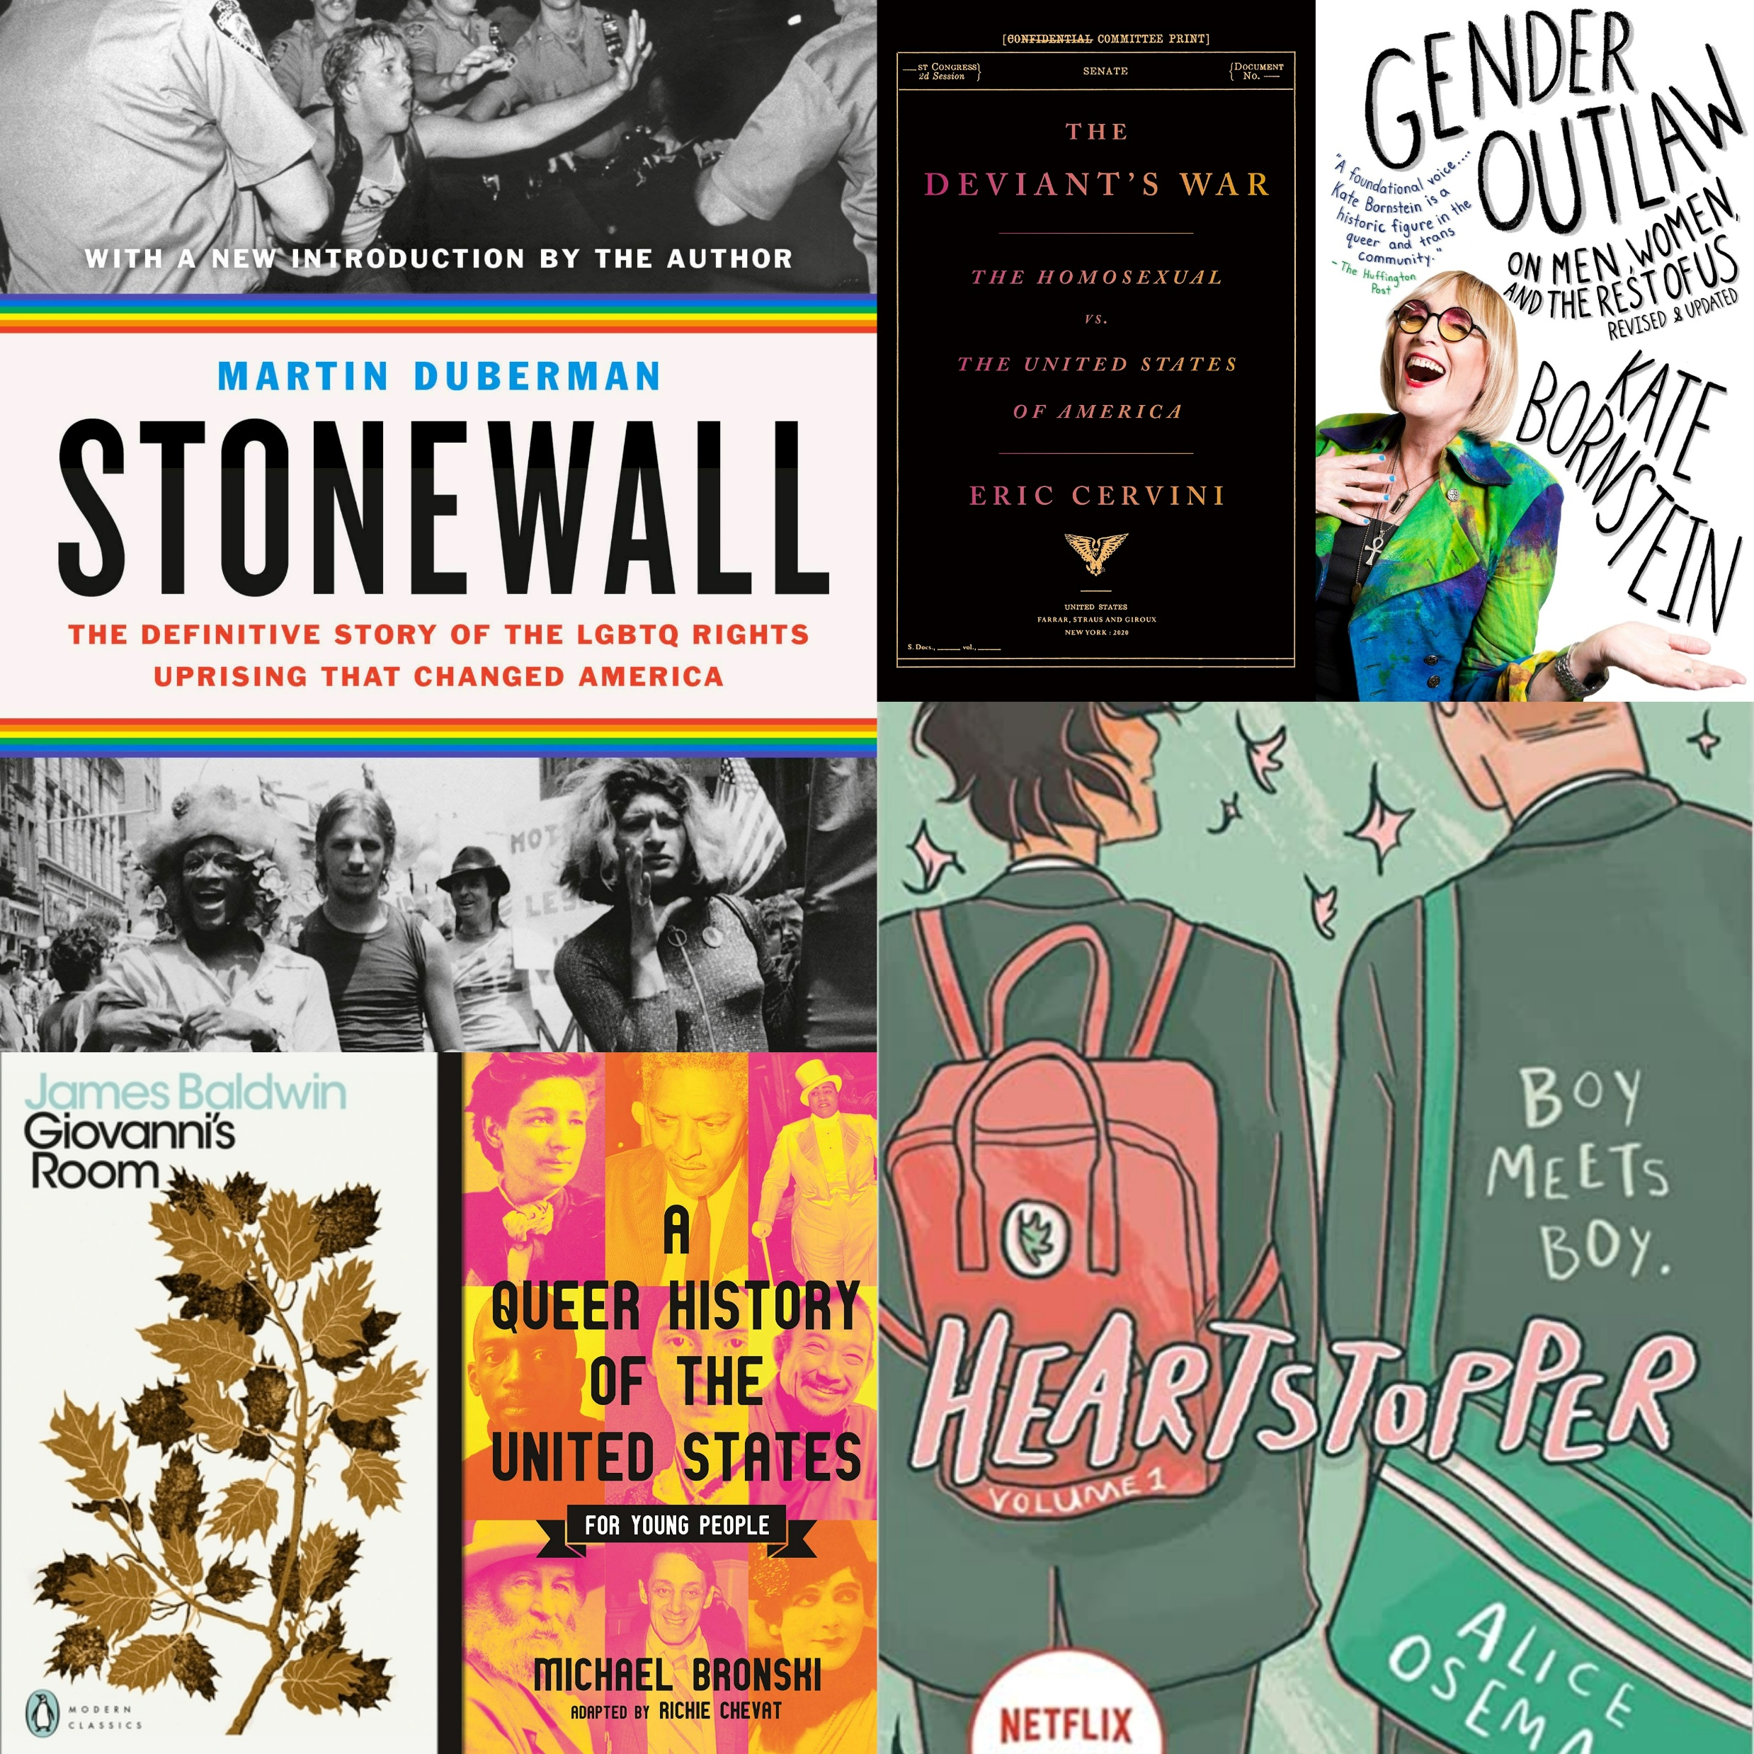
LGBTQIA+
in Books/Literature

Slide 19
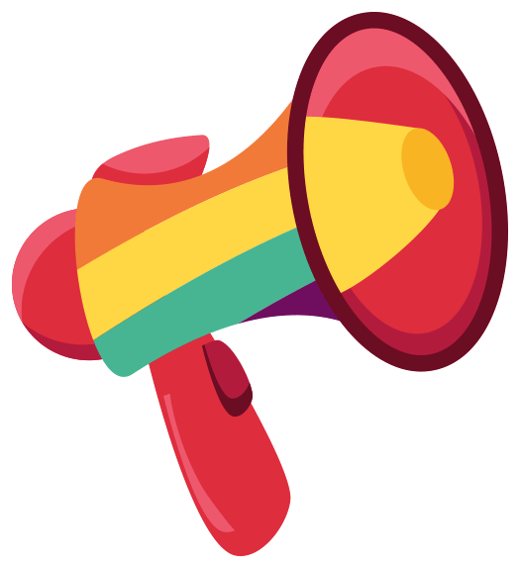
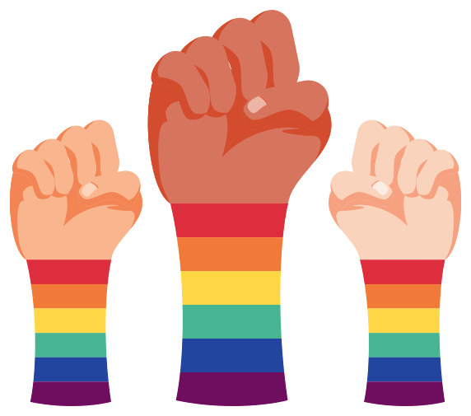

Pride is a Protest
Social Upheaval
Our Rights
Activism
Pride Month is a great time to celebrate everything LGBTQIA+, but it is also an important reminder of how far we’ve come and how far we still must go
Pro Trans laws are being rolled back in America because of Anti-Trans rhetoric in certain political parties and areas of the US. It is important to protest to remind people of how easily our rights can disappear
Protest is one form of activism and we can find our own way to stand for LGBTQIA+ rights

Slide 20
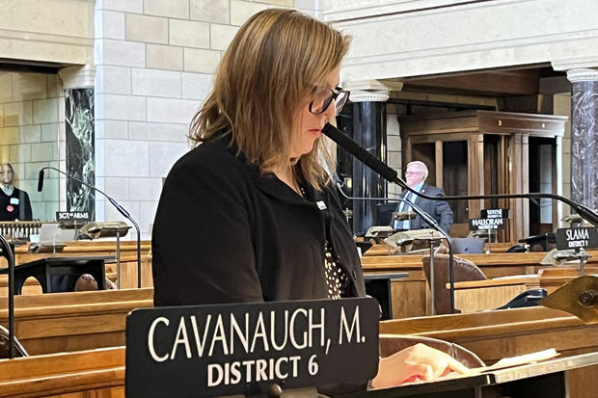
How to be an Ally
Senator Machaela Cavanaugh
Michaela Cavanaugh Filibuster Nebraska Trans Bill
Notes:
Filibuster - a way to prolong debate to delay or prevent a vote on a bill, resolution, amendment, or other debatable question.
It was a mundane, unanimously supported bill on liquor taxation that saw state Sen. Machaela Cavanaugh take to the mic on the Nebraska Legislature floor last week. She offered her support, then spent the next three days discussing everything but the bill, including her favorite Girl Scout cookies, Omaha's best doughnuts and the plot of the animated movie "Madagascar.“
She also spent that time railing against an unrelated bill that would outlaw gender-affirming therapies for those 18 and younger. It was the advancement of that bill out of committee that led Cavanaugh to promise three weeks ago to filibuster every bill that comes before the Legislature this year — even the ones she supports.
"If this Legislature collectively decides that legislating hate against children is our priority, then I am going to make it painful — painful for everyone," the Omaha married mother of three said. "I will burn the session to the ground over this bill."
True to her word, Cavanaugh has slowed the business of passing laws to a crawl by introducing amendment after amendment to every bill that makes it to the state Senate floor and taking up all eight debate hours allowed by the rules — even during the week she was suffering from strep throat. Wednesday marks the halfway point of this year's 90-day session, and not a single bill will have passed thanks to Cavanaugh's relentless filibustering.
The Nebraska bill and another that would ban trans people from using bathrooms and locker rooms or playing on sports teams that don't align with the gender listed on their birth certificates are among roughly 150 bills targeting transgender people that have been introduced in state legislatures this year. Bans on gender-affirming care for minors have already been enacted this year in some Republican-led states, including South Dakota and Utah, and Republican governors in Tennessee and Mississippi are expected to sign similar bans into law. And Arkansas and Alabama have bans that were temporarily blocked by federal judges.
Cavanaugh's effort has drawn the gratitude of the LGBTQ community, said Abbi Swatsworth, executive director of LGBTQ advocacy group OutNebraska. The organization has been encouraging members and others to inundate state lawmakers with calls and emails to support Cavanaugh's effort and oppose bills targeting transgender people.
"We really see it as a heroic effort," Swatsworth said of the filibuster. "It is extremely meaningful when an ally does more than pay lip service to allyship. She really is leading this charge."

Slide 21

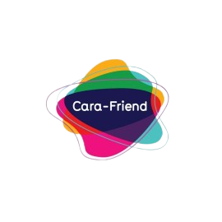
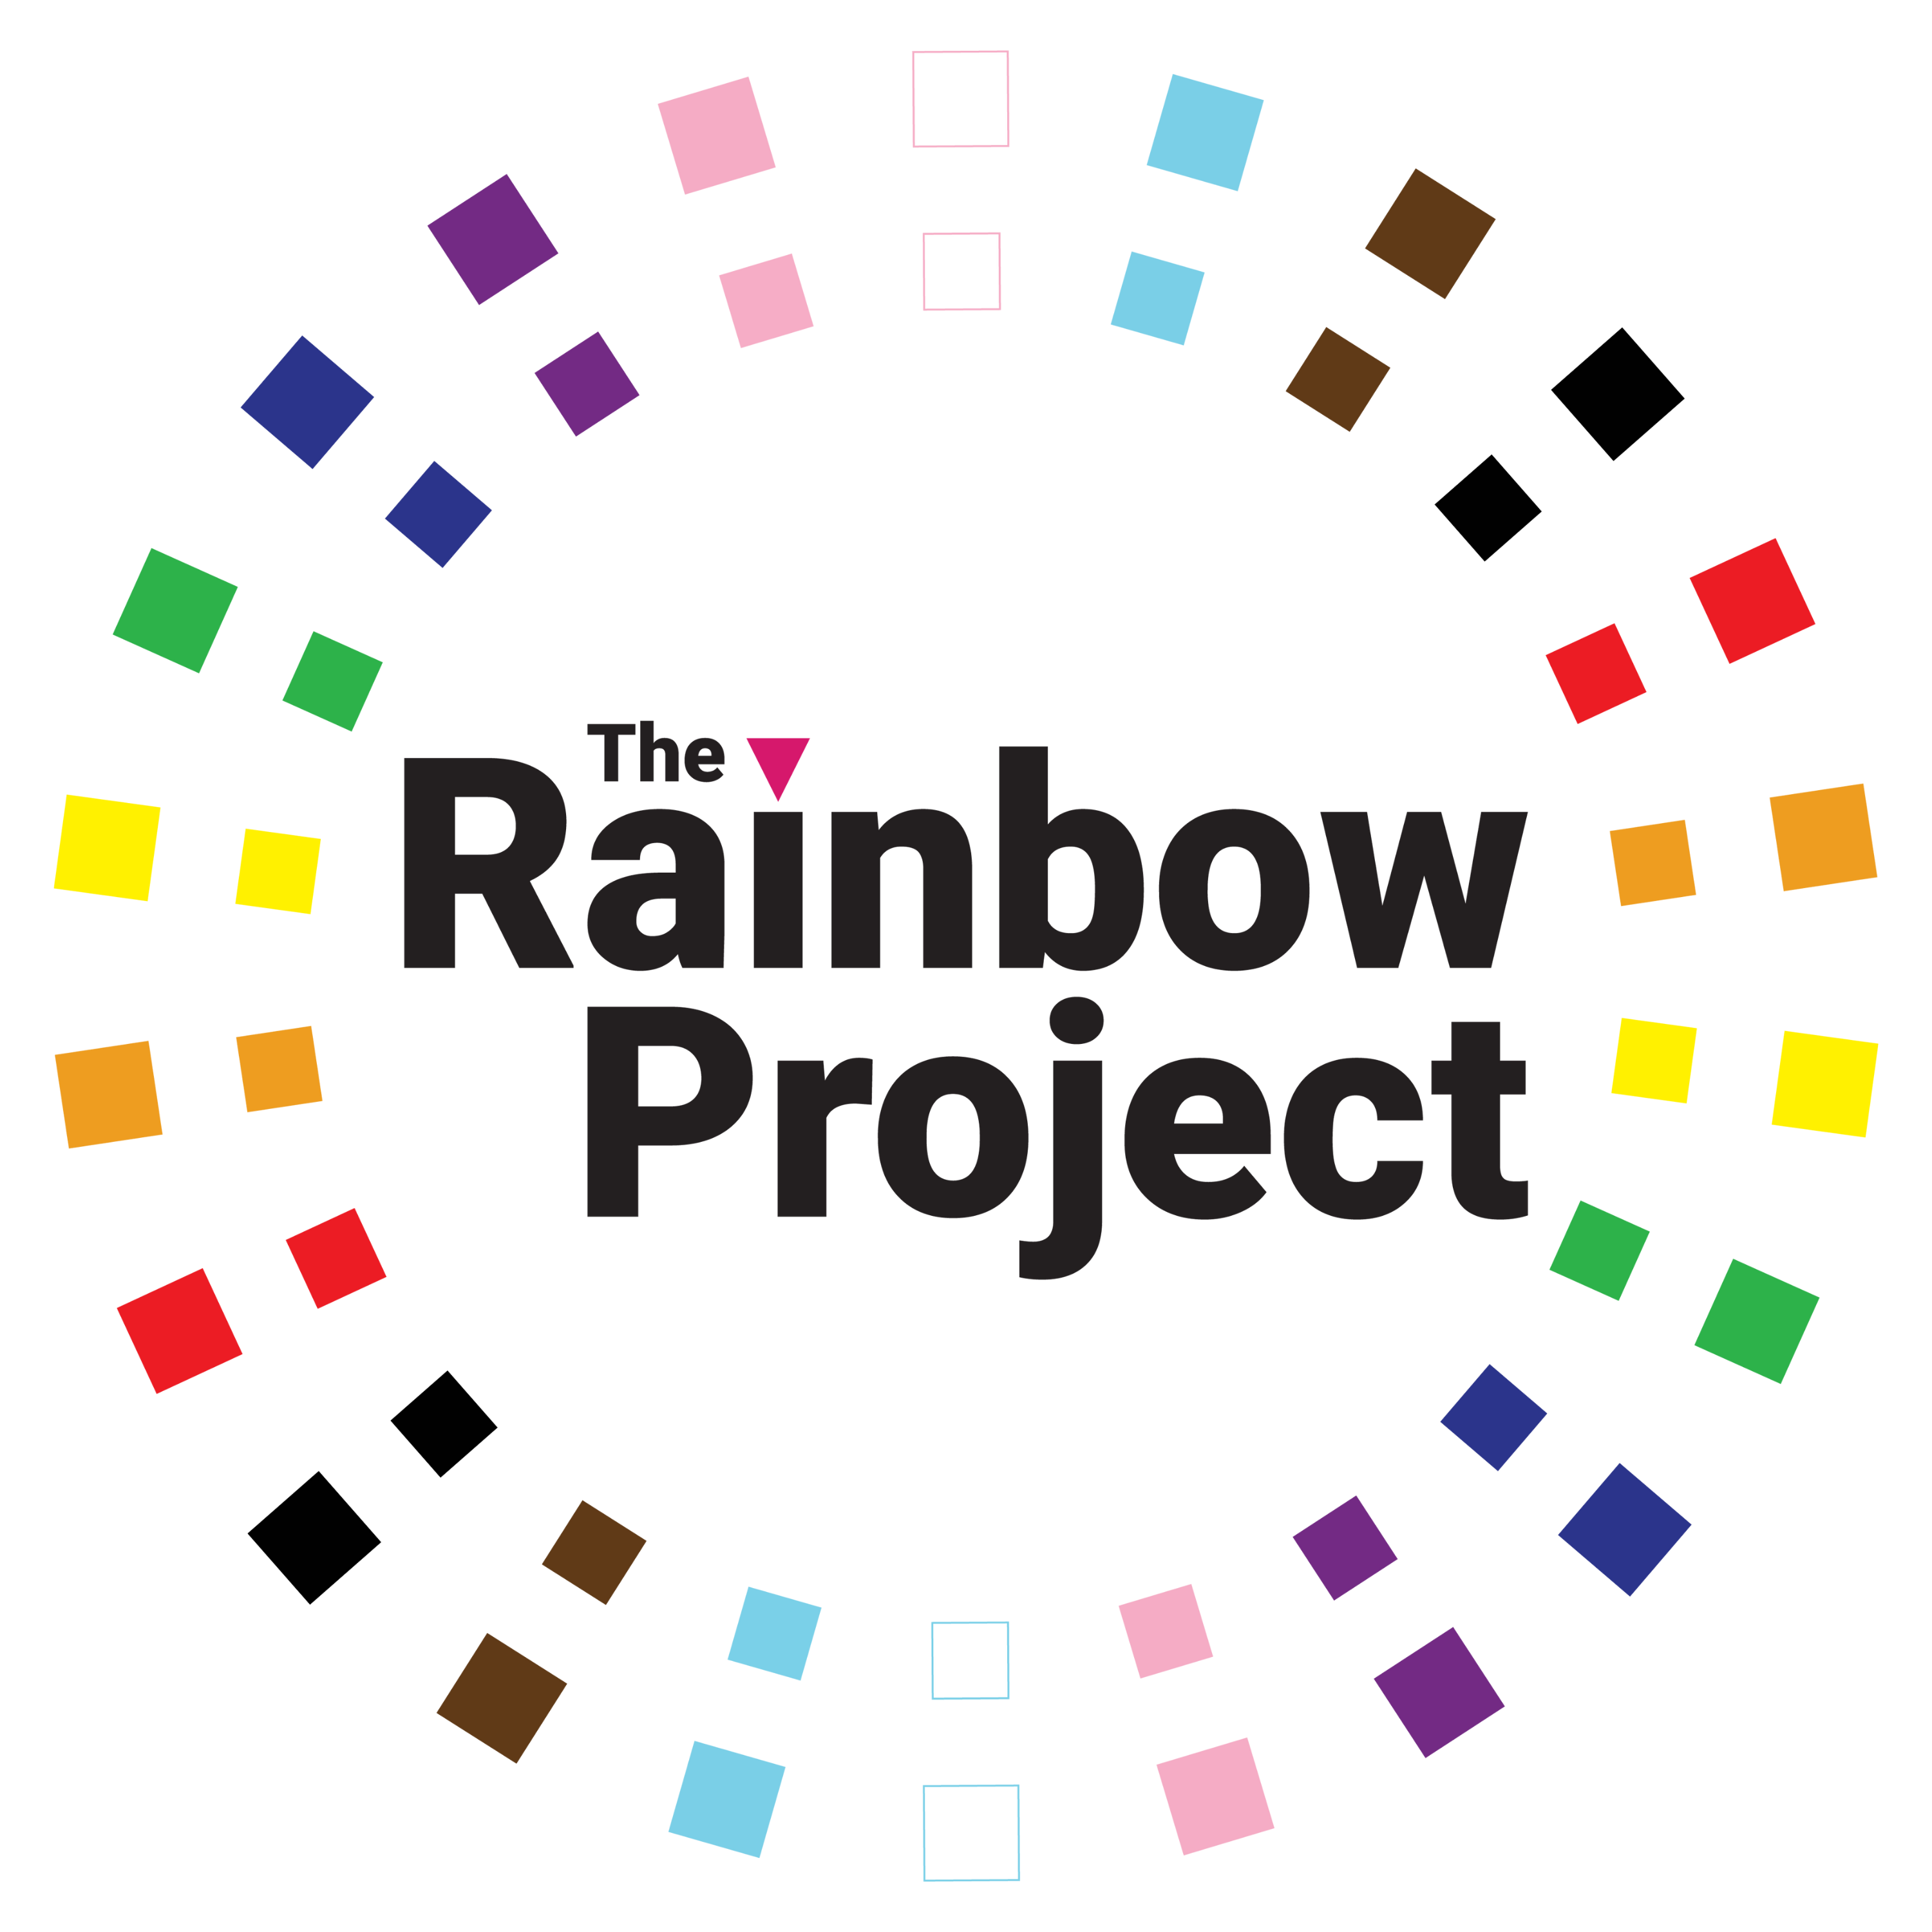


Local LGBTQIA+ Charities
Cara Friend - https://cara-friend.org.uk/
The Rainbow Project - https://www.rainbow-project.org/
HERe NI - https://here875008472.wordpress.com/
Mermaids - https://mermaidsuk.org.uk/
Notes:
Cara Friend have been supporting and impowering LGBTQIA+ people since 1974
The Rainbow Project are committed to the prevention of HIV and STI transmission among men who have sex with men, however, they are also committed to addressing the physical, mental & emotional health needs of LGBTQIA+ people in Northern Ireland.
HereNI is an organisation which works to improve the quality of life and enhance the voices of lesbians and bisexual women and our families. We are committed to identifying and addressing discrimination and oppression, and to the promotion of social inclusion
Mermaids evolved into one of the UK’s leading LGBTQ+ charities that focuses on trans people, empowering thousands of people with its secure online communities, local community groups, helpline services, web resources, events and residential weekends.

Slide 22
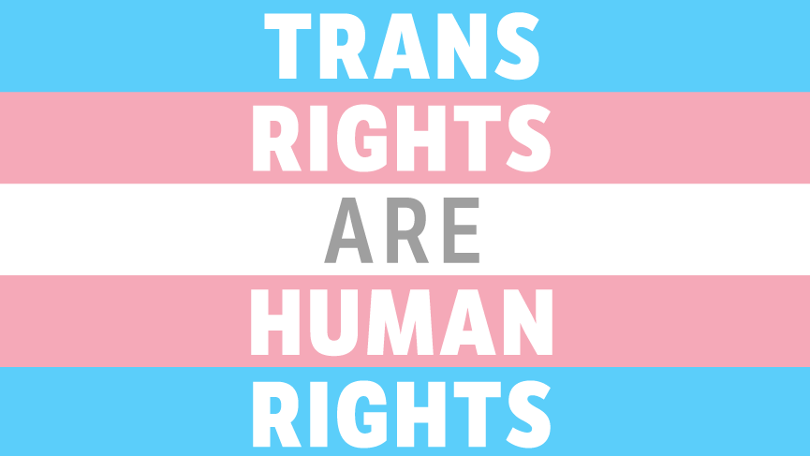
Notes:
I chose to do the presentation today as today is Trans Day of Visibility. There is constant discussion on trans issues in culture today. It is a heavy, divisive political topic especially in America like I discussion earlier about trans rights being repealed.
Here are some hard facts about transgender people and their experience in our heteronormative world:
25% of trans people had experienced homelessness at some point in their lives
Nearly half of trans people (45%) said that their GP did not have a good understanding of their needs as a trans person,
Trans people of colour also experienced transphobia from trans-specific healthcare providers at more than double the rate of white respondents (13% compared to 6%)
The inequality is consistent and must be confronted to ensure trans people have the quality of life we all freely enjoy
===============================================================================
So that’s all very depressing so here are some positive facts about trans people:
Spain approves landmark bill making it easier for trans youth to change gender
https://www.gaytimes.co.uk/life/spain-approves-landmark-bill-making-it-easier-for-trans-youth-to-change-gender/
Ariana Grande pledges $1.5 million to trans youth!
https://t.co/pLXF5QsAO0
Mexico's Supreme Court rules that under 18s must be able to change birth certificates!
https://t.co/fBobFWGDns
So it’s not all bad. You’ve got to see the positives in the many negatives
https://static1.squarespace.com/static/5e8a0a6bb02c73725b24dc9d/t/6152eac81e0b0109491dc518/1632824024793/Trans+Lives+Survey+2021.pdf

Slide 23
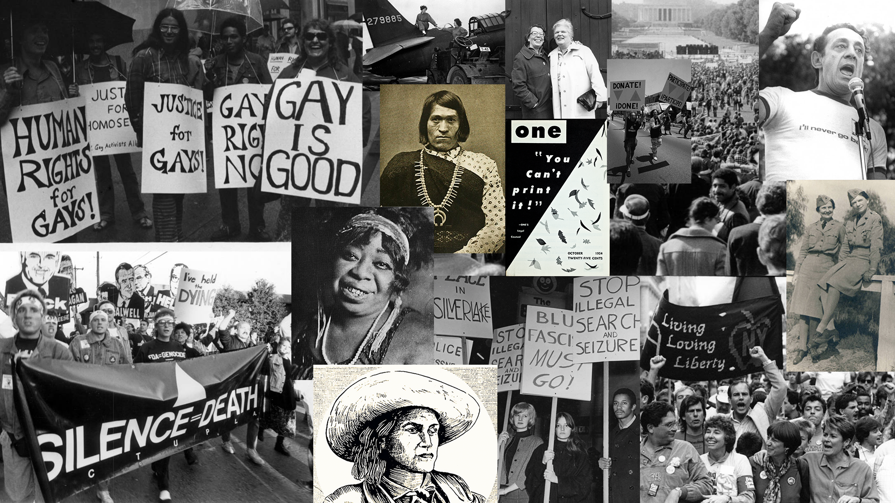
Notes:
So I’ll finish on this photo. It shows that queer history is not just recent and contemporary to our current world but that it has been around for a long time, for a millennia.
Queer people were living in secret for years, suffering in silence, taking all kinds of abuse.
It is only in our recent history that education, legislation, protesting and love has helped get to the openness and acceptance we experience today from all kinds of people in all walks of life.
Our history is always with you. It is a well woven tapestry with colour, joy, humour, love, fabulousness and a hell of a lot of glitter!
What I mean to say is – everybody’s welcome in my house!

Slide 24
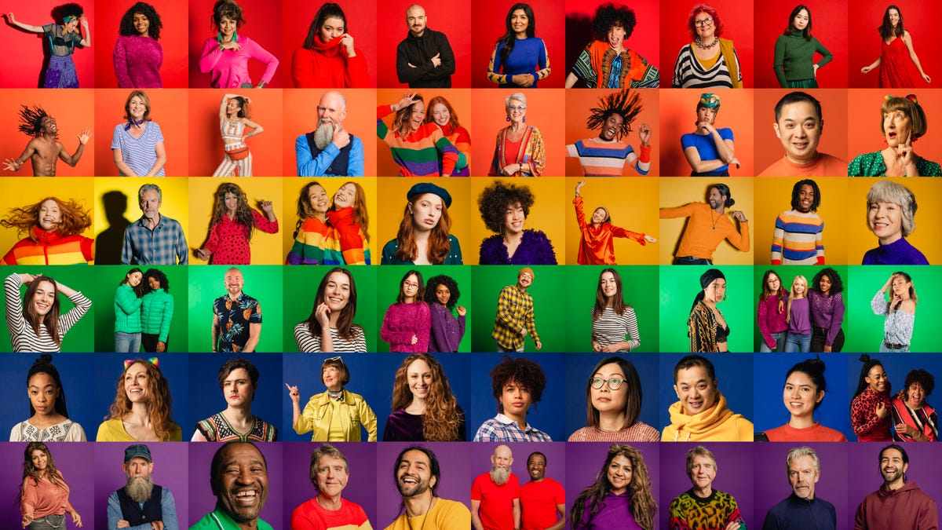
Everybody's Welcome in My House!

Slide 25
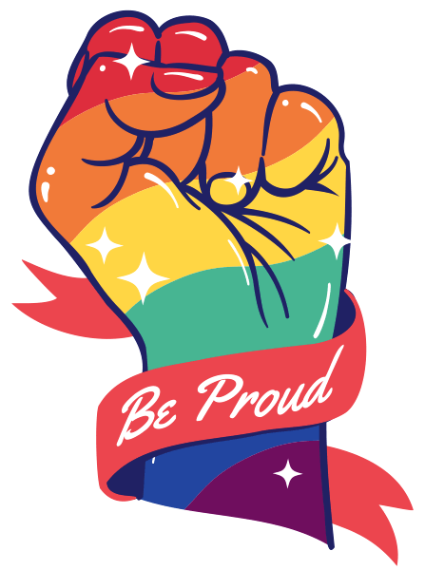
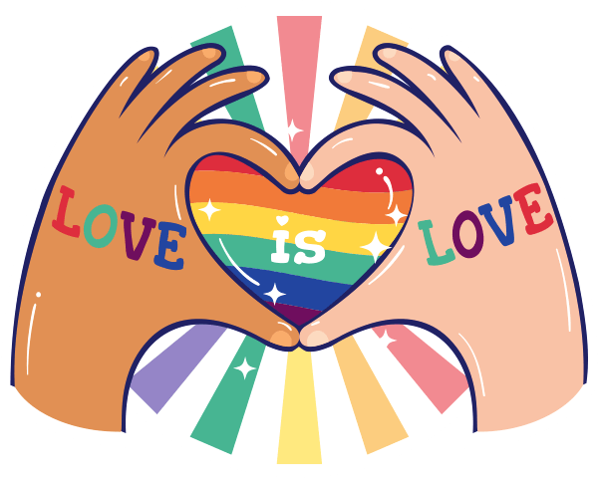
Thank You!

